Slide 1
Wordly Wise Vocabulary Lesson 5
Find the vocabulary word that matches the picture. Write it down on your whiteboard.

Slide 2
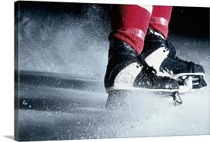

Slide 3
abrupt

Slide 5
achieve

Slide 6
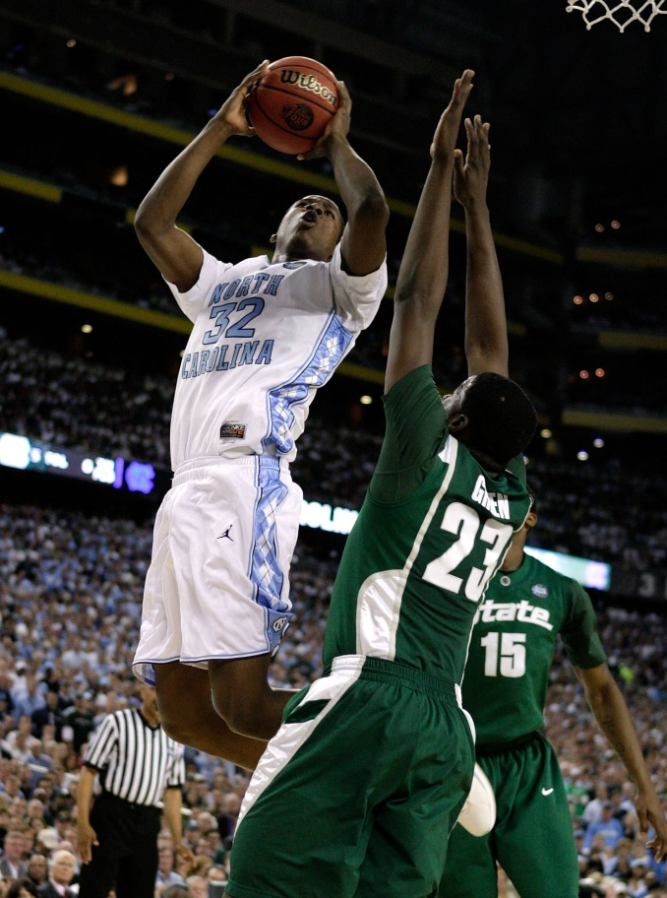

Slide 7
attempt

Slide 9
contempt

Slide 10
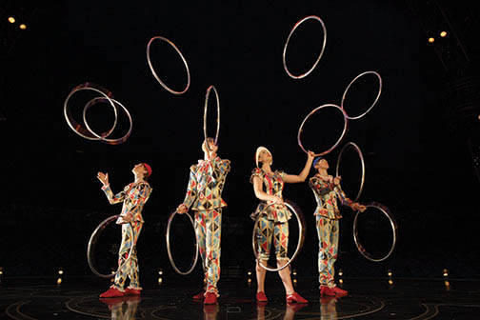

Slide 11
entertain

Slide 12
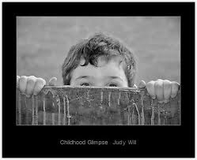

Slide 13
glimpse

Slide 14
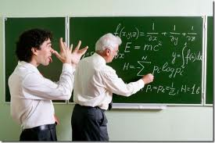

Slide 15
mock

Slide 16
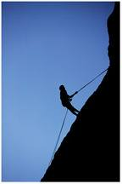

Slide 17
persist

Slide 19
persuade

Slide 20
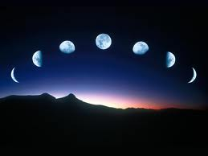

Slide 21
phase

Slide 22
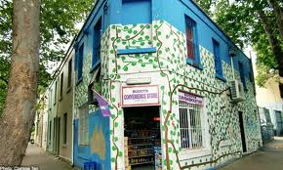

Slide 23
quaint

Slide 25
recall

Slide 27
reject

Slide 28
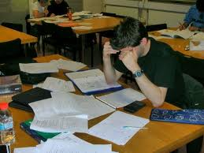

Slide 29
revise

Slide 31
sensitive

